Slide 1
Open Service Mesh Crash Course
Rahul Rai
Tarun Pabbi

Slide 2
Rahul Rai Microsoft Azure MVP
Group Product Manager
Tarun Pabbi Cloud Solution Architect
LogicMonitor

Slide 3
Agenda
Value Proposition of Service Mesh
Open Service Mesh
Demo

Slide 4
Introduction to Service Mesh
Introduction & Architecture

Slide 5
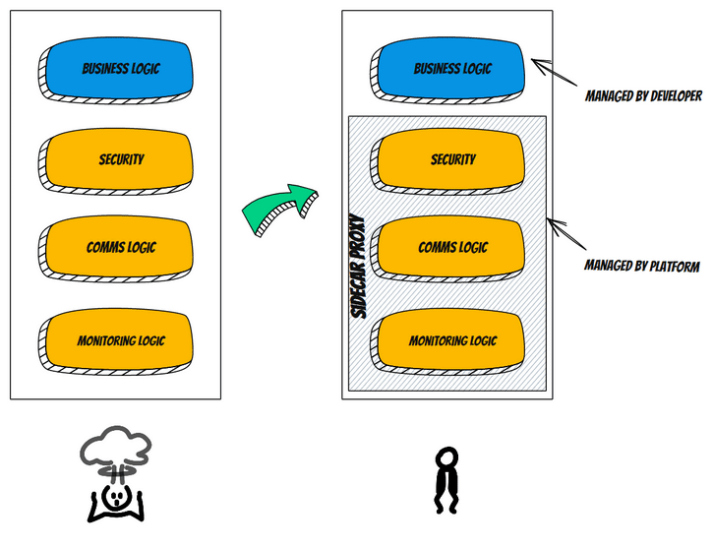
A Service Mesh
Moves operational responsibilities to the infrastructure layer
Provides capabilities like:
Encrypt east-west traffic
Traffic management
Canary rollouts
Observability

Slide 6


Architecture
Control Plane manages the service mesh
Data Plane is a proxy that is injected as a sidecar to the workload
UI or API interface
Manages the rule & policy definitions
Manages security controls such as strong identity and certs for mTLS
Aggregates metrics & telemetry
Controls network traffic in & out of the workload pod
Can be configured to:
Secure traffic via mTLS
Dynamically route traffic
Apply traffic policies
Collect metrics and traces

Slide 7
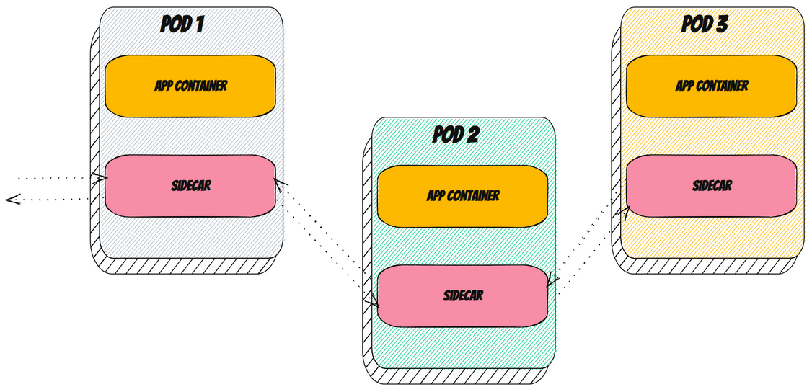
Architecture

Slide 8



Limitations
Adds complexity to the architecture
Requires expertise in addition to K8s
Adds a little latency

Slide 9
Open Service Mesh

Slide 10

Open Service Mesh
Simple to understand and contribute to
Effortless to install, maintain, and operate
Painless to troubleshoot
Easy to configure via Service Mesh Interface (SMI)
openservicemesh.io

Slide 11
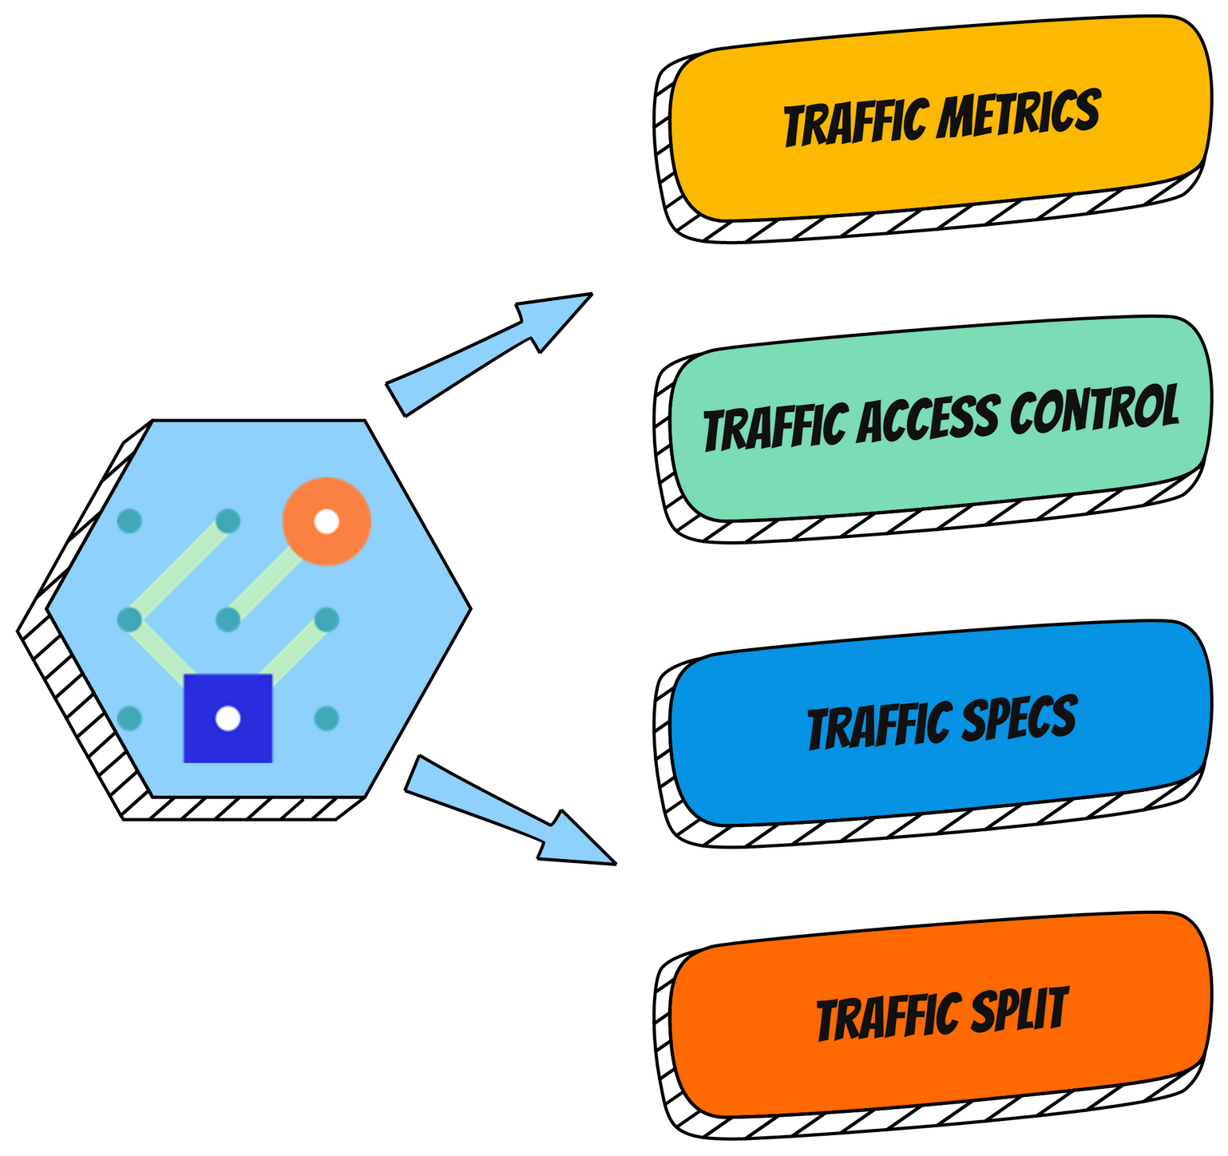
Service Mesh Interface
A standard interface for service meshes on Kubernetes
A basic feature set of the most common service mesh use cases
Flexibility to support new service mesh capabilities over time
smi-spec.io

Slide 12
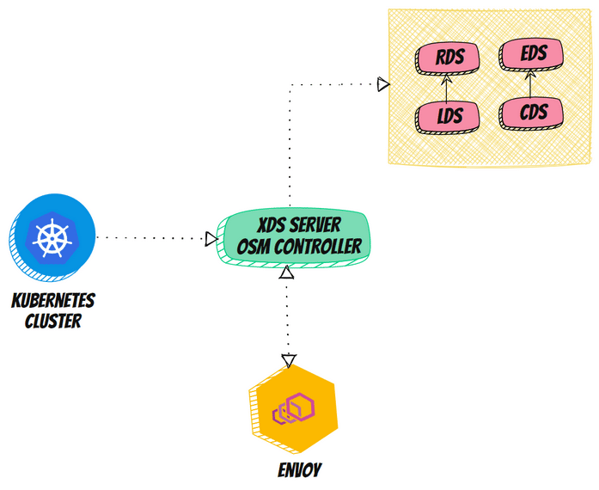
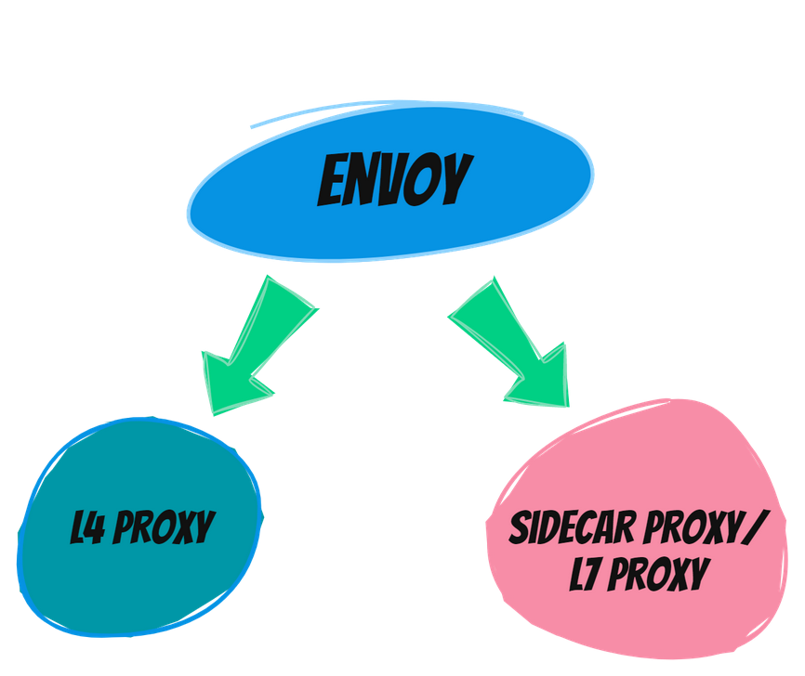
Envoy & OSM
“Envoy is an open-source edge and service proxy designed for cloud-native applications”
envoyproxy.io

Slide 13
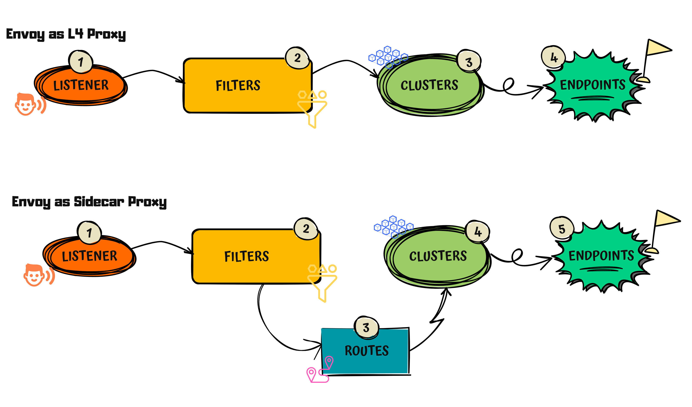
Key Parts of Envoy’s Configuration

Slide 14
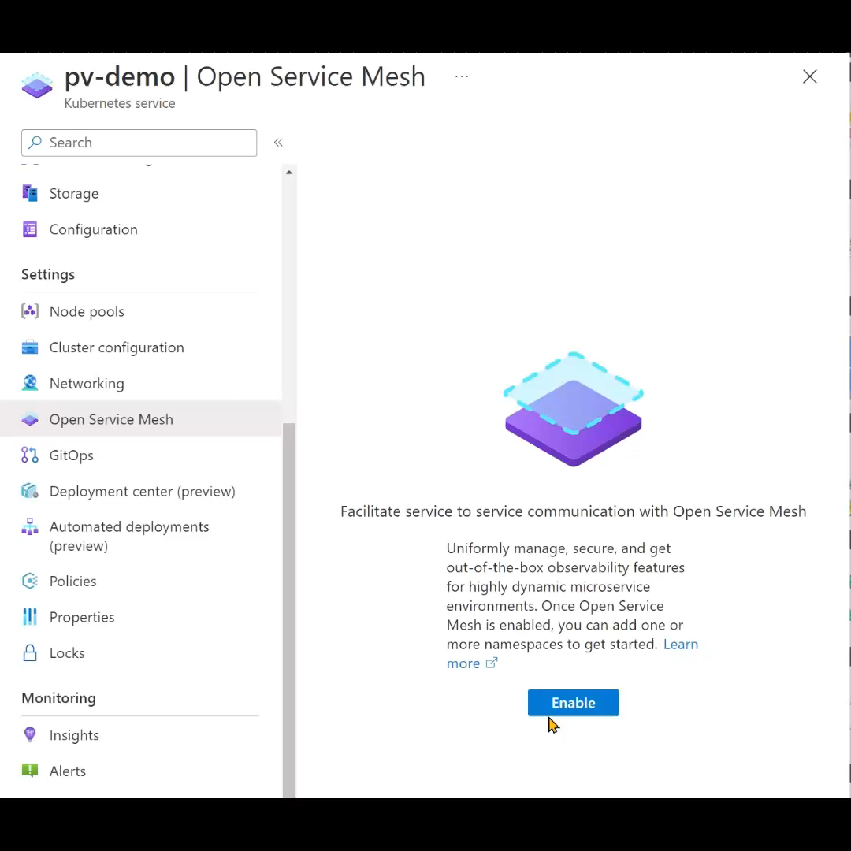
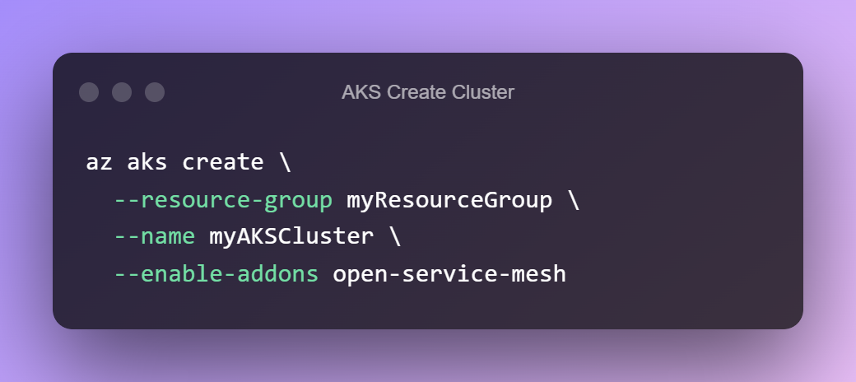
OSM AKS Add-on

Slide 15
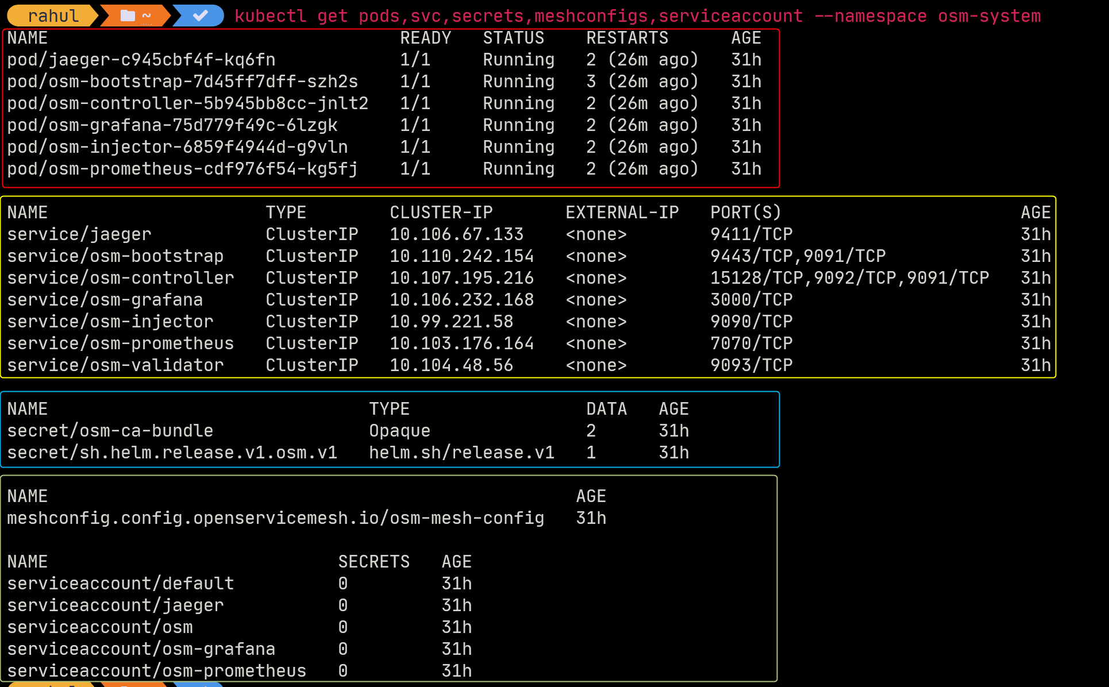
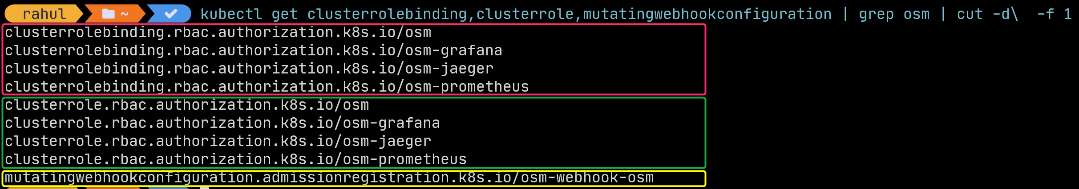
Objects Installed
Notes:
Demo the following:
1. What gets installed on the cluster
2. The volume that gets mounted with a dynamic listener pointing to osm-controller

Slide 16
Demonstrations

Slide 17
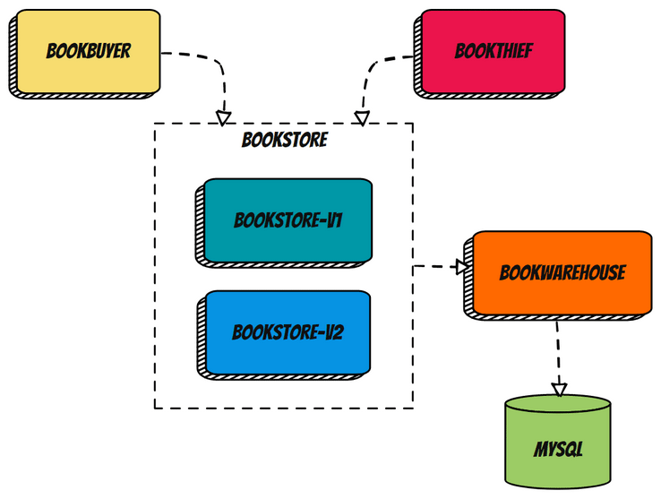
Application Overview
Applications deployed to Kubernetes with Envoy sidecars
Exposed UIs through NGINX Ingress
Patterns
SMI traffic policy
Traffic splitting
Egress management
Monitoring

Slide 18
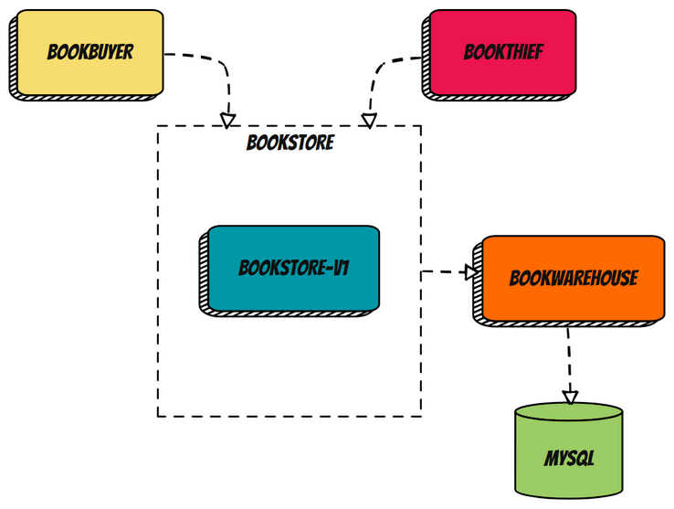
SMI Traffic Policy
Enable flow of traffic between services
Use permissive traffic policy mode to allow traffic by default

Slide 19
Traffic Splitting
Enable balancing of traffic between different versions of the Bookstore service
Key use cases:
A/B testing
Canary rollouts

Slide 20

Egress Management
Use the Egress policy to control access to services outside the mesh
Can manage:
Access to the Internet
Access to the services external to the service mesh

Slide 21
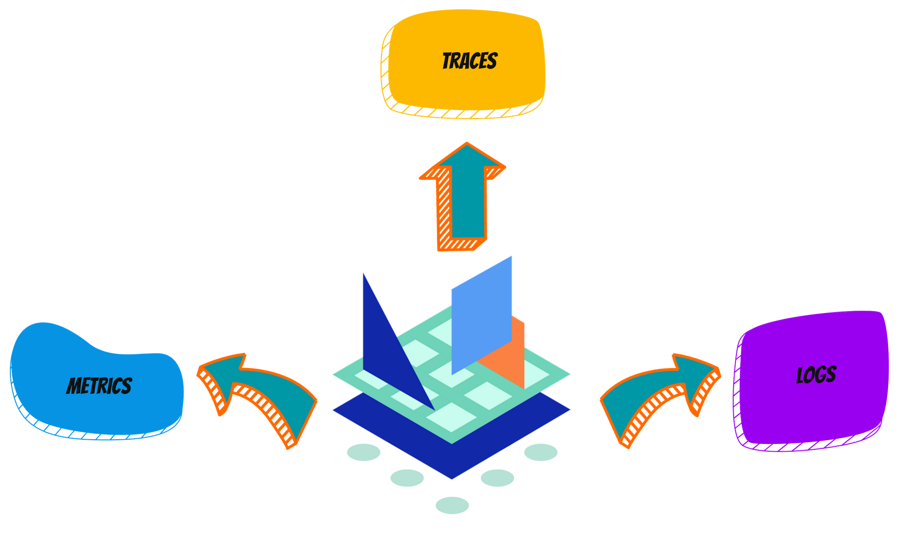
Observability
Metrics: Proxy and OSM control plane Prometheus metrics
Traces: Tracing with Jaeger
Logs: Diagnostic logs from the OSM control plane

Slide 22


Summary
Use of Service Mesh in Microservices architecture
Sidecar pattern
Envoy's role in OSM
SMI APIs
OSM patterns

Slide 23


Resources
Open Service Mesh AKS add-on
Open Service Mesh
Service Mesh Interface
bit.ly/osm-cc

Slide 24





Q&A
Rahul Rai Tarun Pabbi
@rahulrai_in @tarunpabbi7
thecloudblog.net tarunpabbi.com

